Slide 1


CIS 4560 Big Data: IMDB
Cesar Lopez
Michael Cheung
Brian Wonse
Tan Huynh

Slide 2
Table of Contents
Objectives
What is IMDb?
Related Works
Significance & Relation
Data Information and Source
Experimental Specifications
Dataset Interface
Geo-Spacial Visualization
Workflow Chart
Problems Encountered
Github

Slide 3
Objectives: Learn Data Analysis with Hive and IMDB
Download online files with command-line utility wget.
Unzip files with gzip.
Rename files with mv.
Create Directories in HDFS.
Put files into HDFS Directory.
List data in HDFS Directory.

Slide 4
Objectives: Learn Data Analysis with Hive and IMDB
Create tables in HDFS.
Load data into HDFS tables.
Join HDFS Tables
Place files in HDFS directory into local server.
Download data from local server to local machine

Slide 5
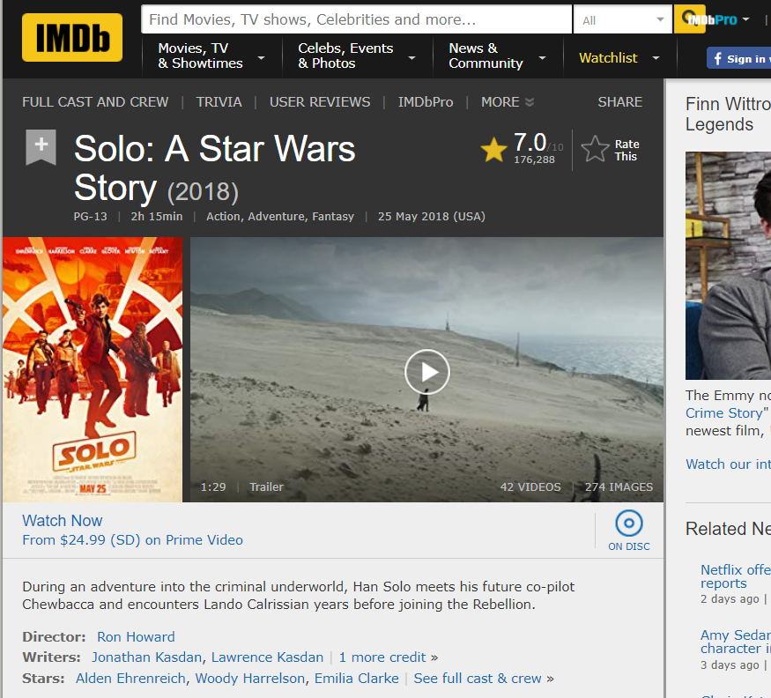
IMDb
IMDB is an online database of information related to films, television programs, home videos, etc.
“The world's most popular and authoritative source for movie, TV and celebrity content.” -imdb

Slide 6
Related Works 1
IMDb Exploratory Data Analysis by Ilya Ezepov (January 5, 2015) Focus: Movies and Genres
Goal: Find a correlation between major historical events and the production of movies during these eras.
Subgoal: Creating a predictive model on favorable movie genres with a correlative relation between ratings and genres.
Language: Statistical Language R

Slide 7
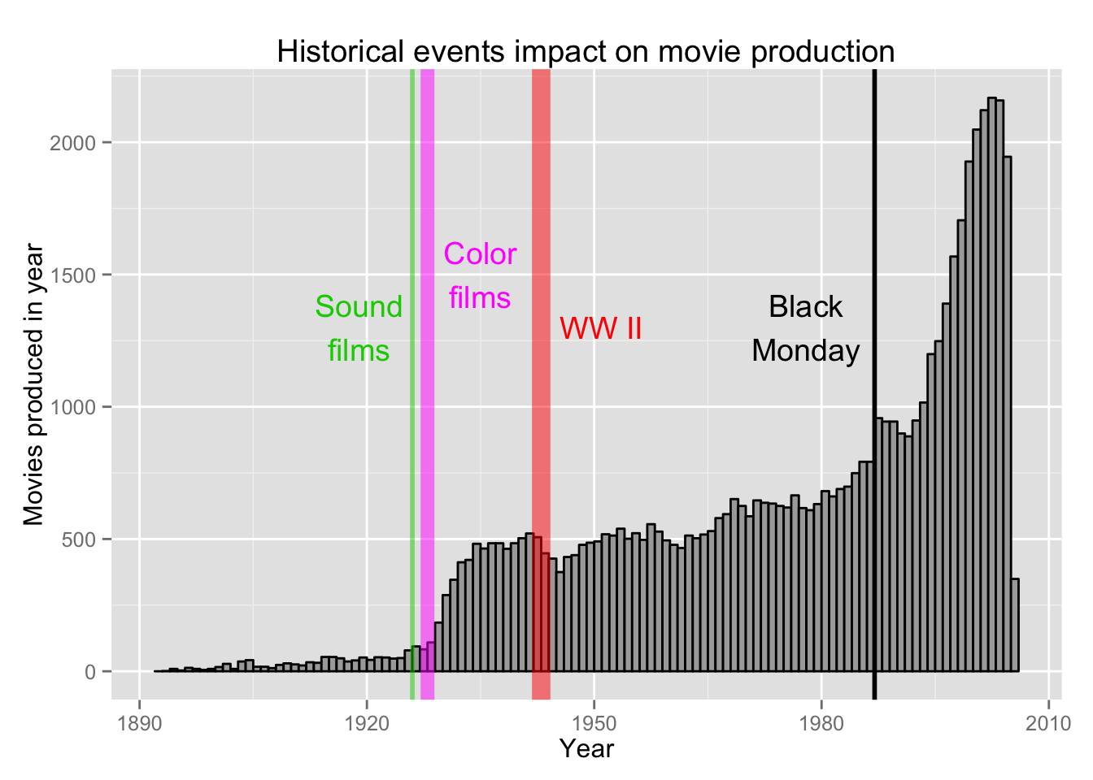
IMDb Exploratory Data Analysis by Ilya Ezepov (January 5, 2015)

Slide 8
Related Works 2
Movie Lens & IMDb Data Analysis by T.J. Gray (April 28, 2018)
Focus: Movie Lens Database and IMDb Database
Goal: Does a high number of votes lead to a lower rating? (In both IMDB and Movie Lens)
Subgoal: Which genre has higher ratings in Movie Lens and IMDb and why?
Language: Statistical Language R

Slide 9
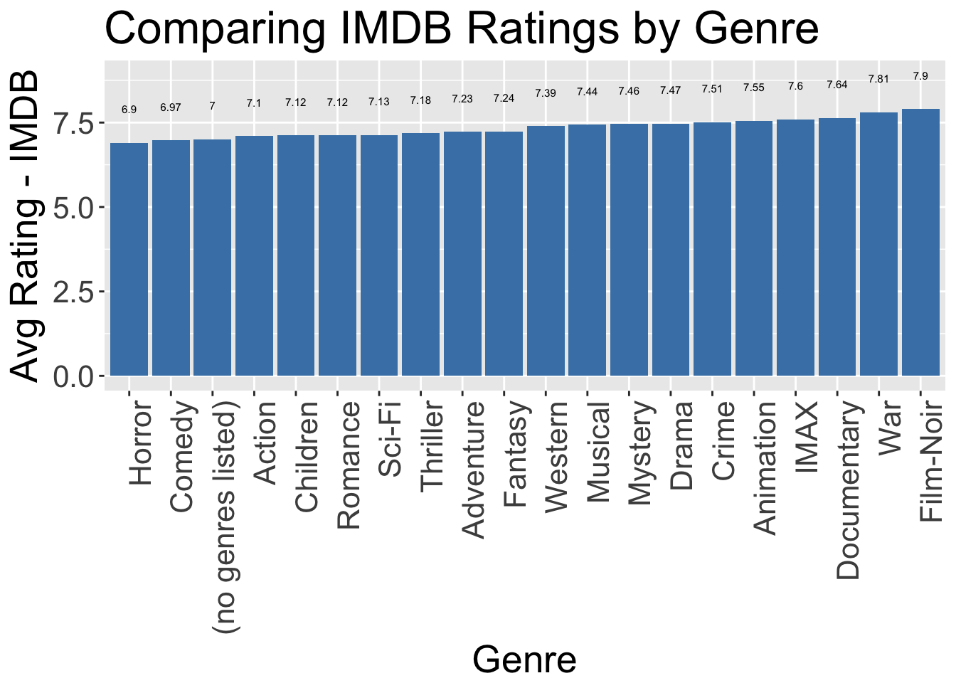
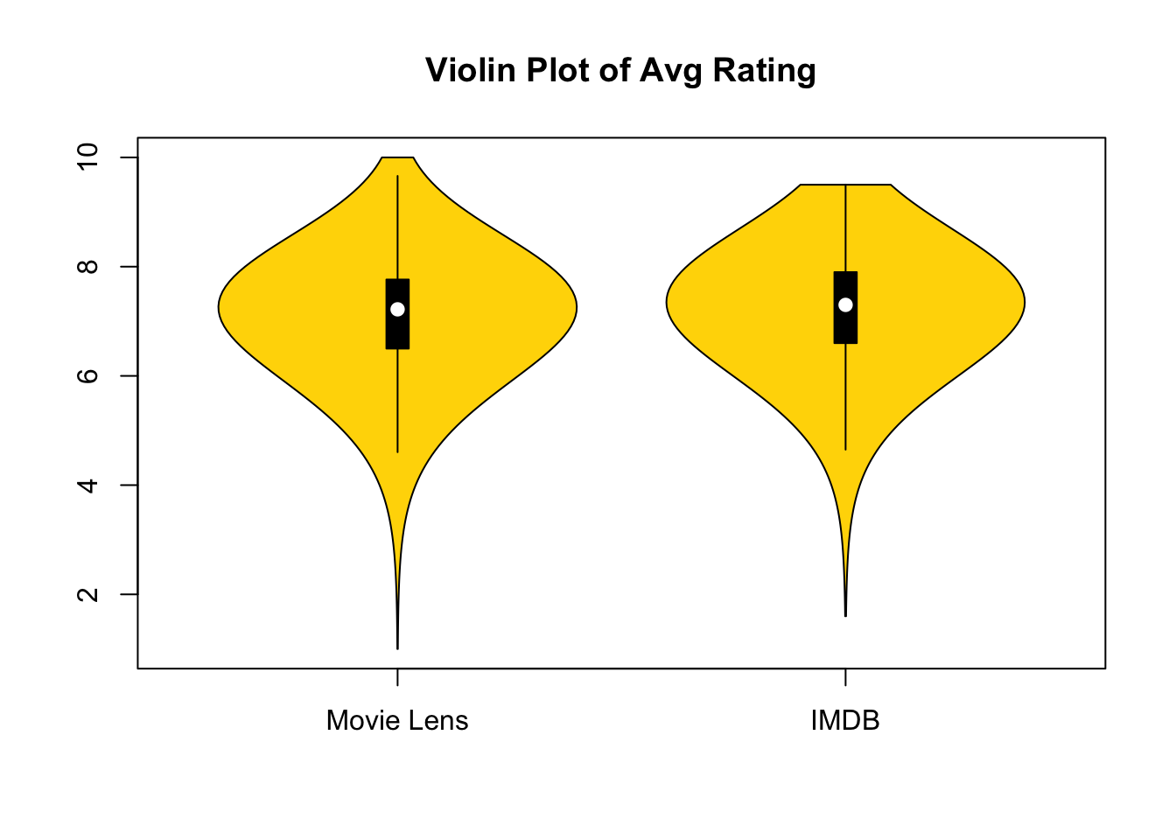
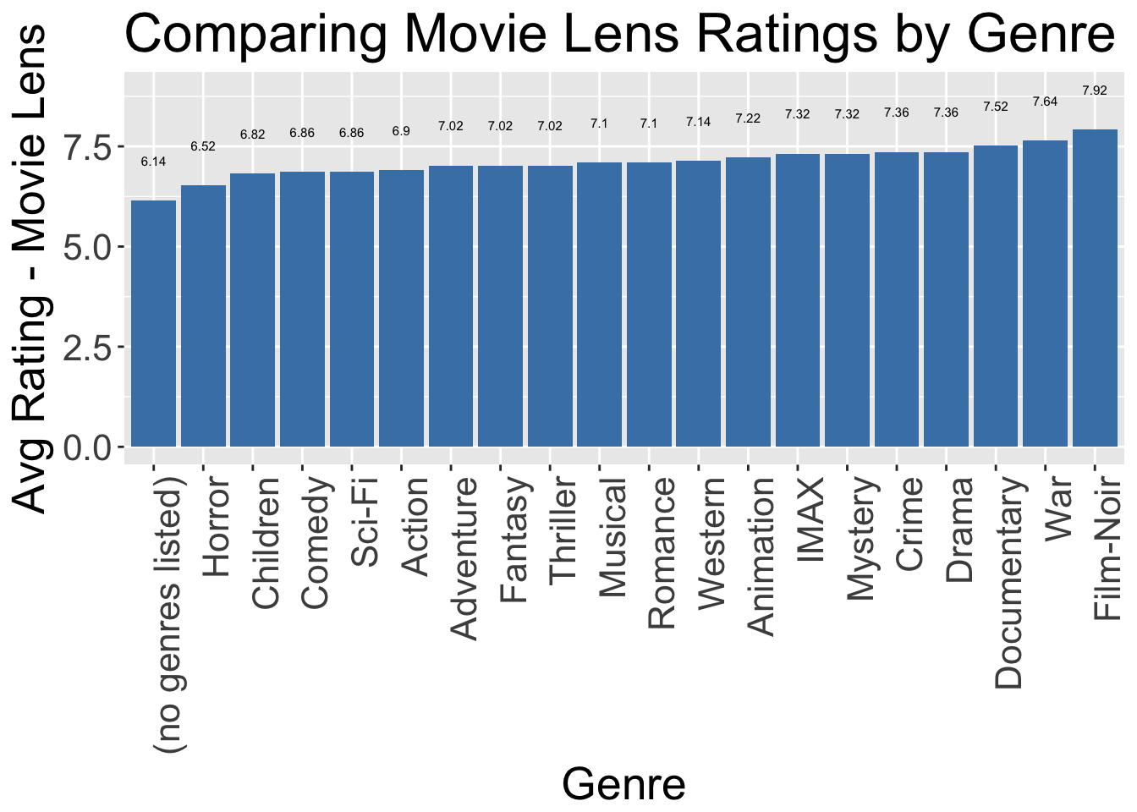
Movie Lens & IMDb Data Analysis by T.J. Gray (April 28, 2018)

Slide 10
Significance and Relation
In the 21st century, media such as shows and movies play an extremely important role in people’s everyday lives. Media such as shows and movies has improved in quality and have become much more easily accessible. Through it, it bears a manipulative or influential vibe pushed upon viewers that would affect how they think, live, and develop.
Goal: Create a geomap and pie charts show shows counted mediatypes released in a specific years by region.

Slide 11
Data Source URLS
https://datasets.imdbws.com/name.basics.tsv.gz https://datasets.imdbws.com/title.akas.tsv.gz https://datasets.imdbws.com/title.basics.tsv.gz https://datasets.imdbws.com/title.crew.tsv.gz https://datasets.imdbws.com/title.episode.tsv.gz https://datasets.imdbws.com/title.principals.tsv.gz https://datasets.imdbws.com/title.ratings.tsv.gz

Slide 12
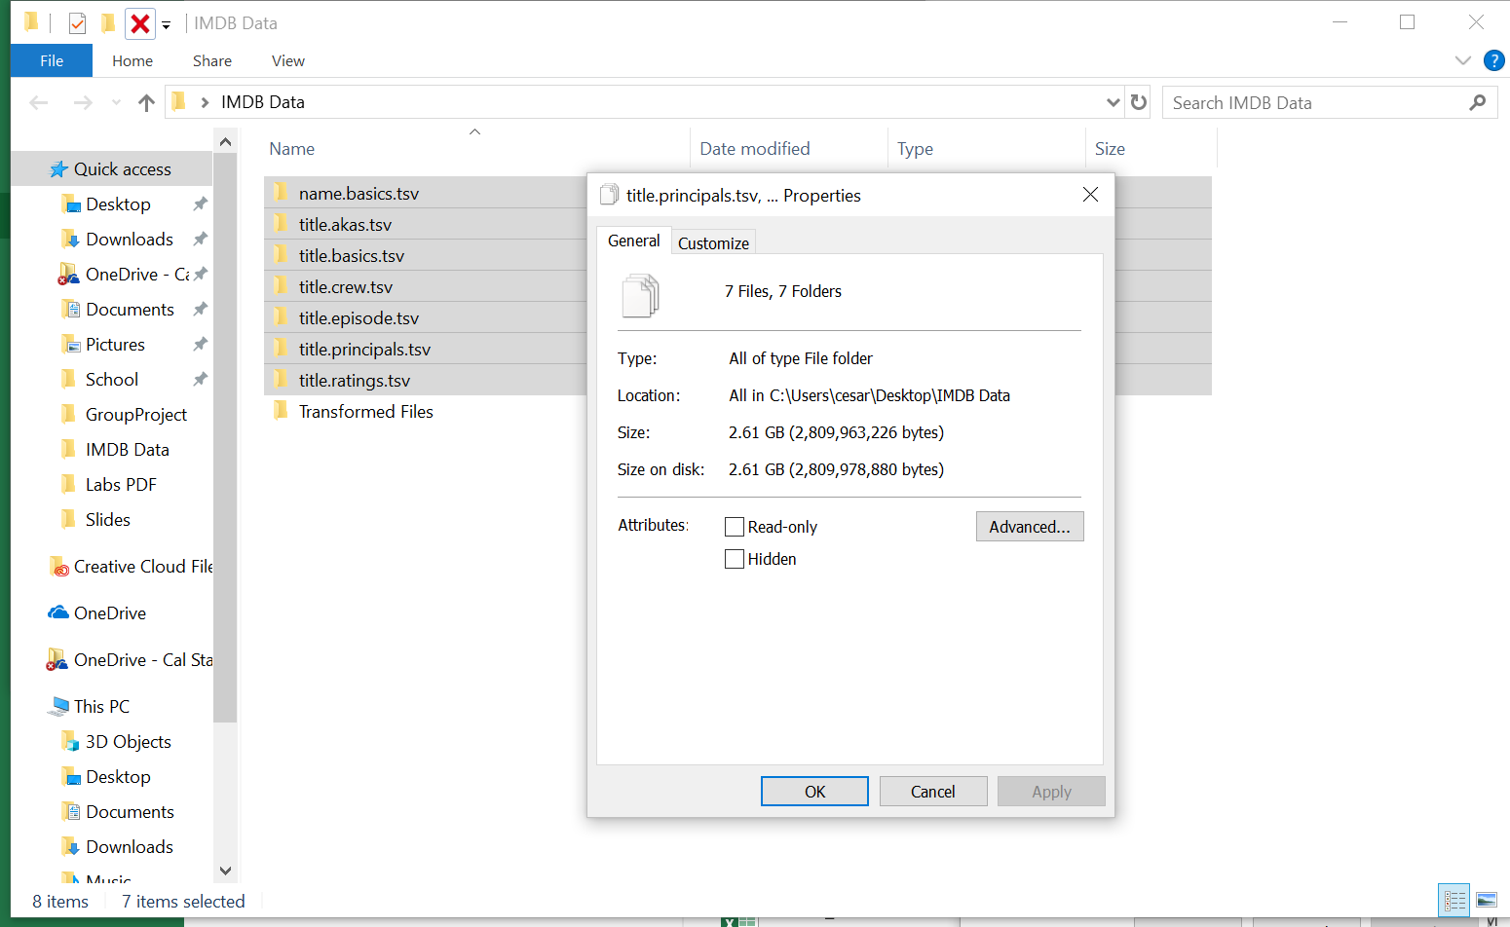
Data Size
After downloading and unzipping files:
Total Data Size: 2.61 GB

Slide 13
H/W Experimental Specifications
IBM Cloud Analytics Engine: Lite Plan RAM Size: 16GB # of CPU cores: 4 CPU Speed: 2195.294 MHz # of nodes: 1 Total Memory Size: 600GB HDFS Space

Slide 14
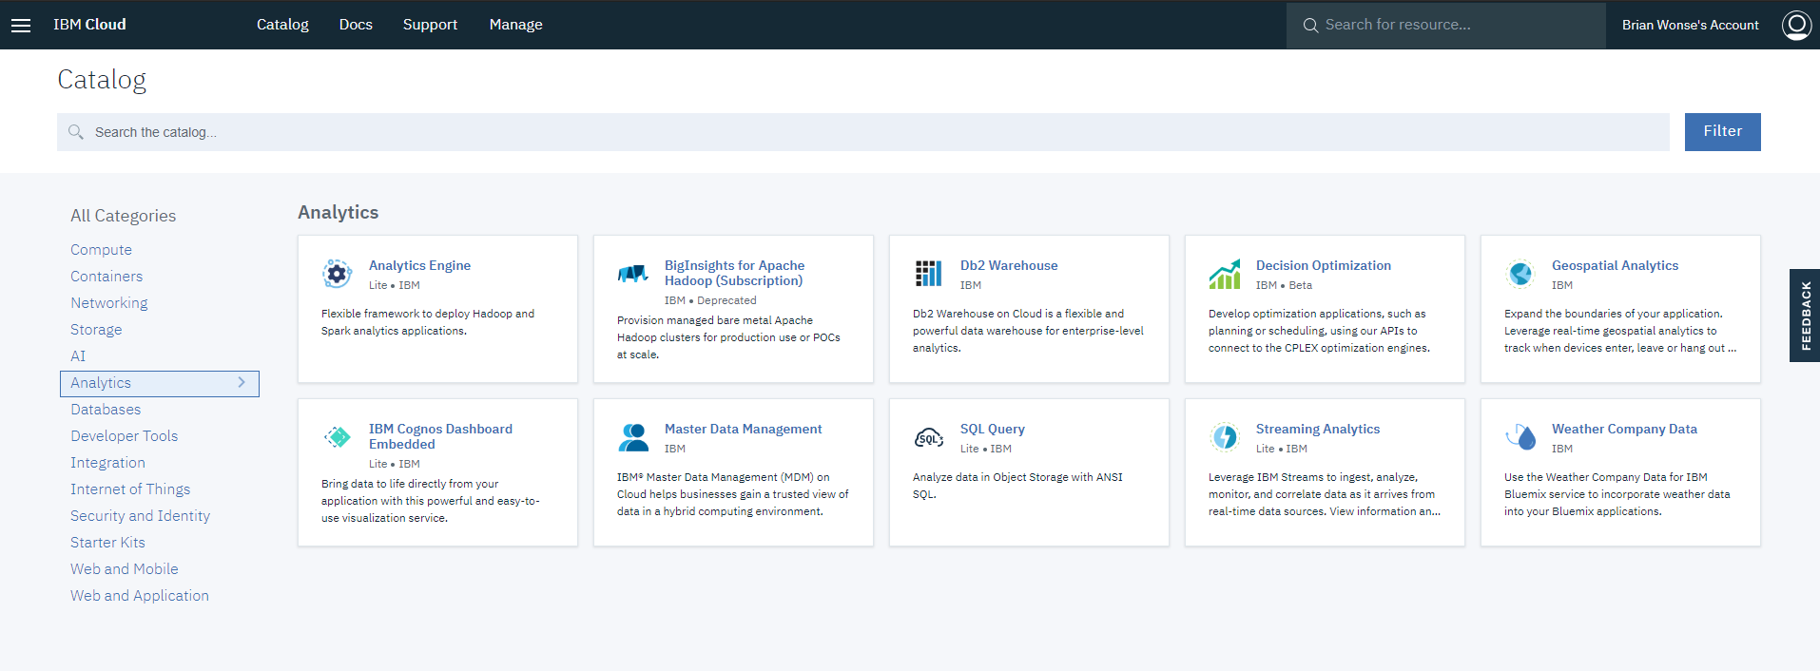

Slide 15
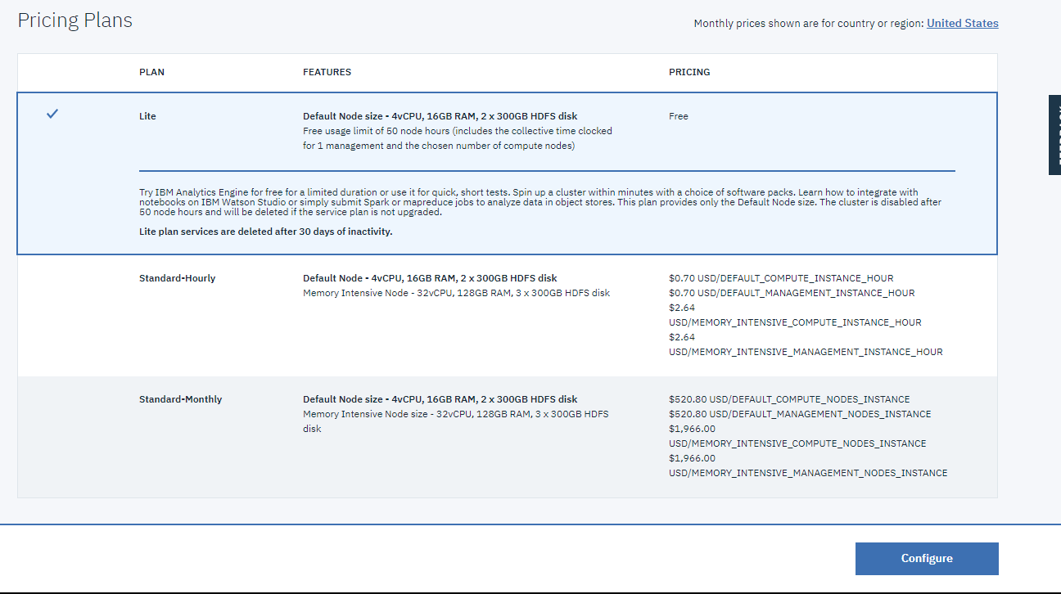

Slide 16
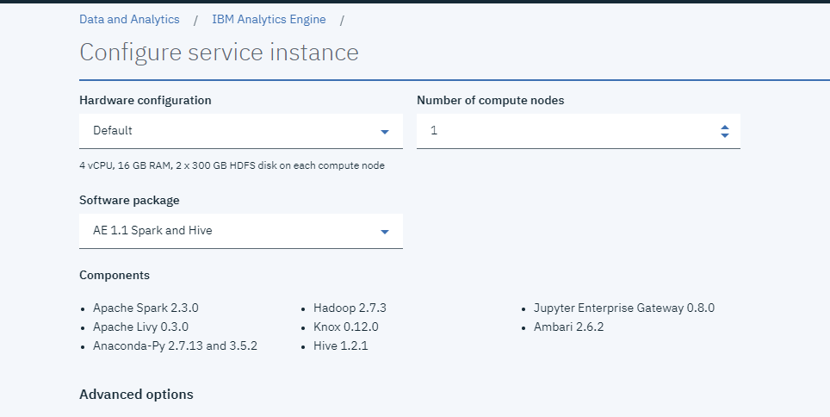

Slide 17
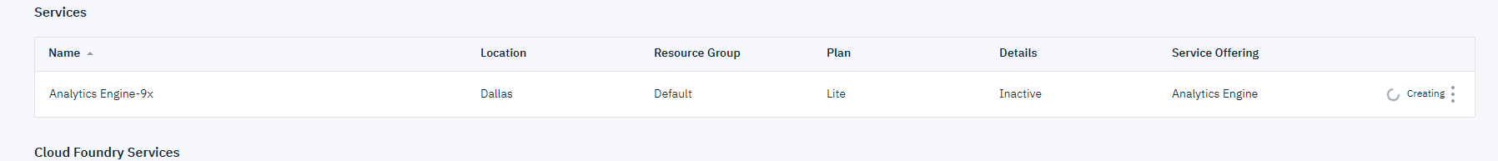

Slide 18
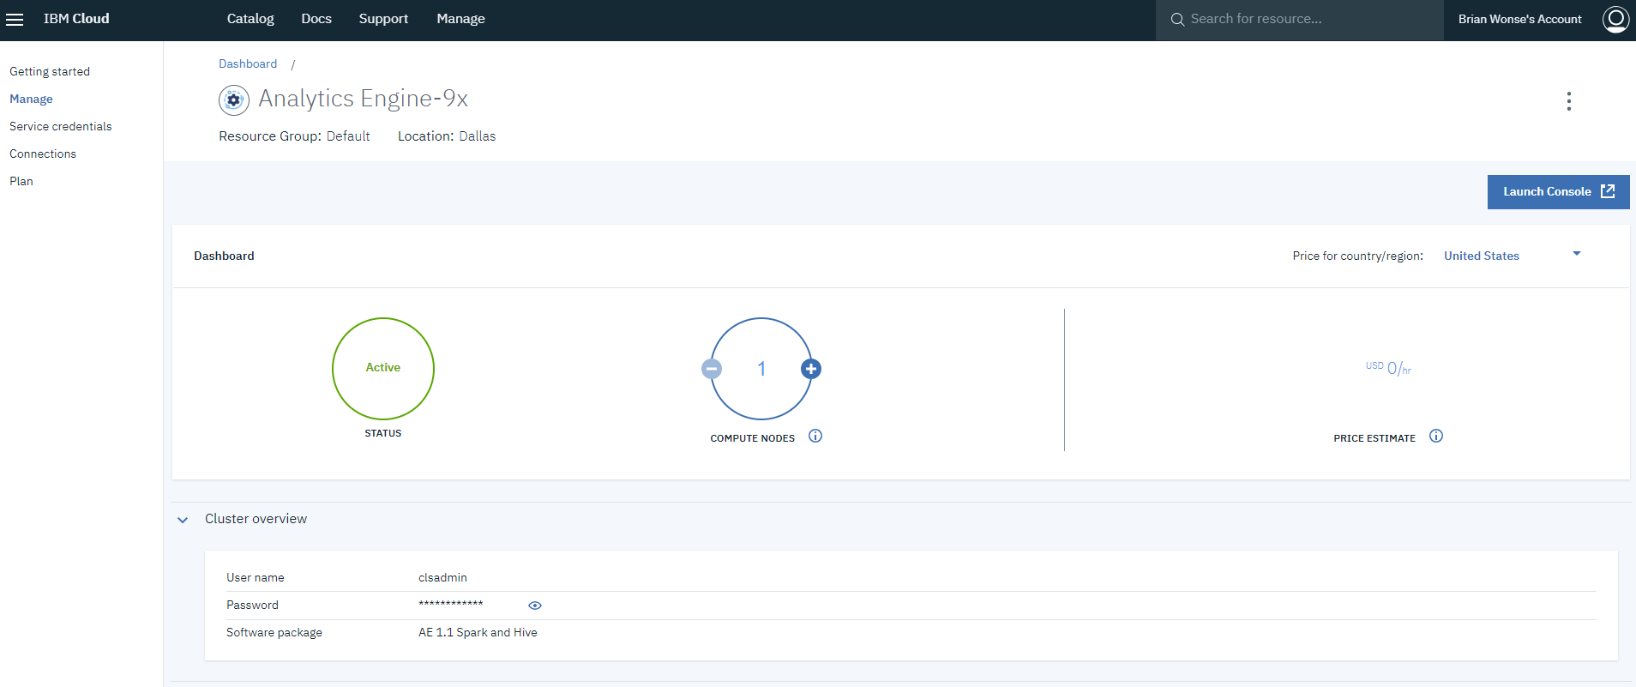

Slide 19
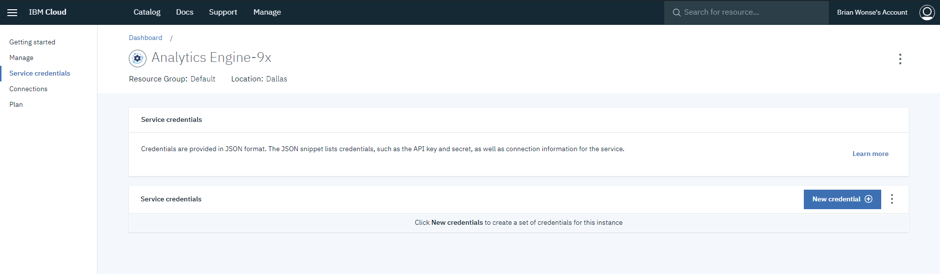

Slide 20
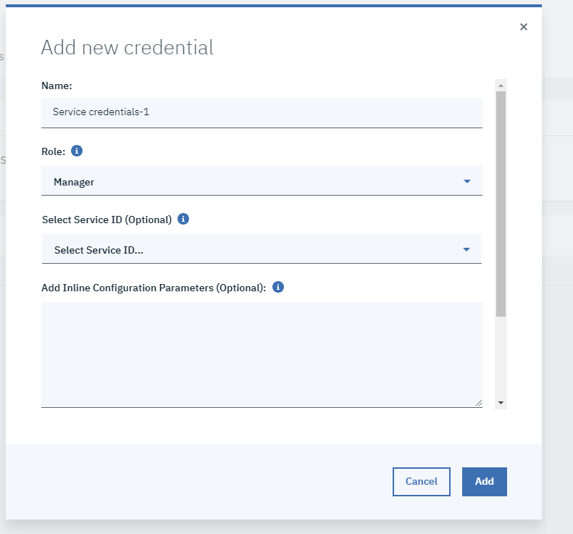

Slide 21
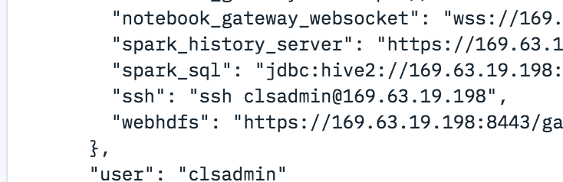
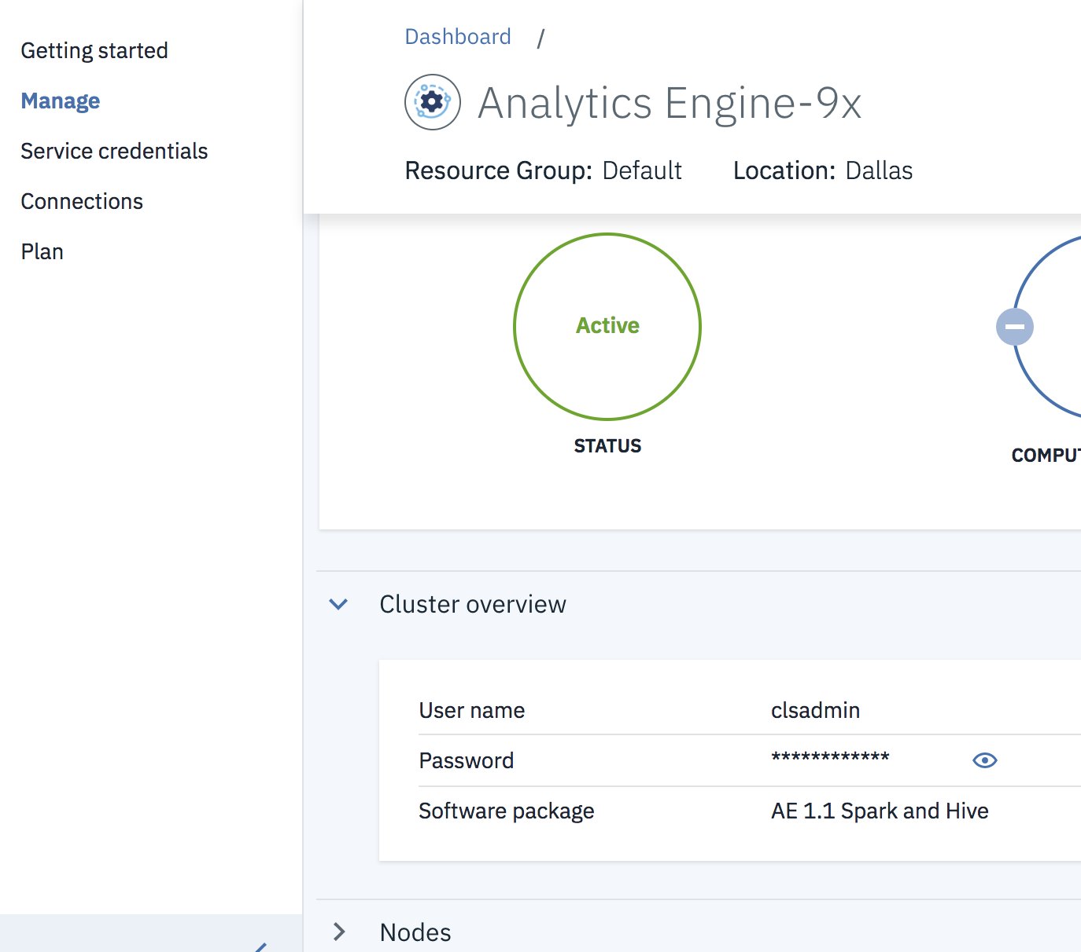

Slide 22
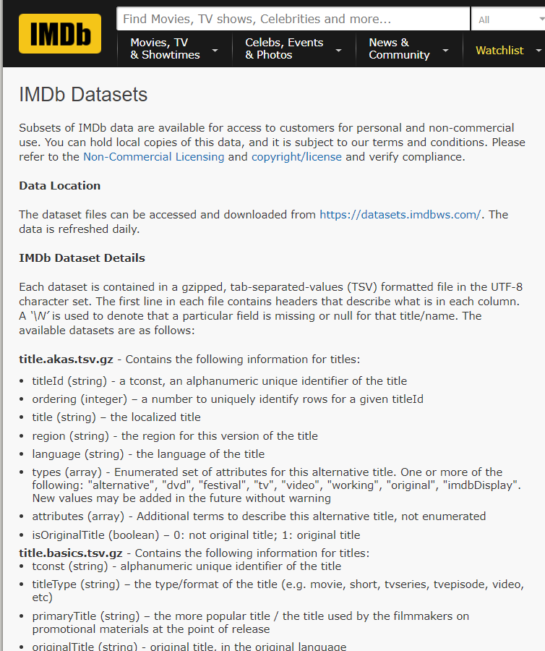
Interface
https://www.imdb.com/interfaces/
Information about column data in tables downloaded from imdb.

Slide 23
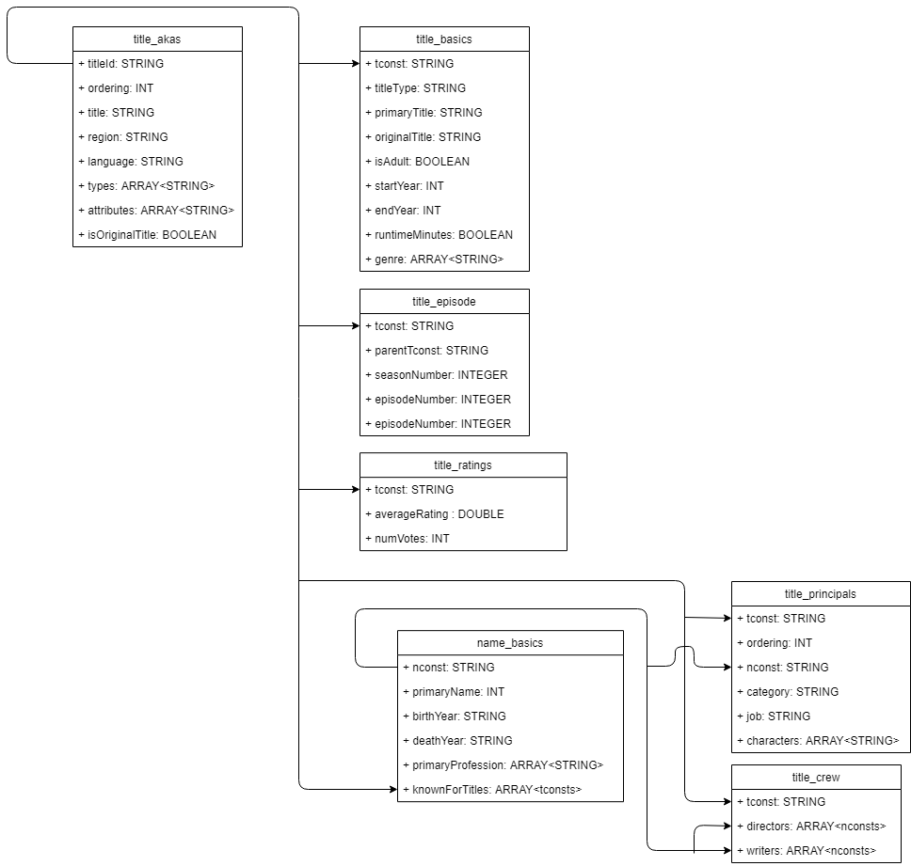
Workflow UML Diagrams
Useful columns:
titleID & tconst
Region
titleType
startYear
genres

Slide 24
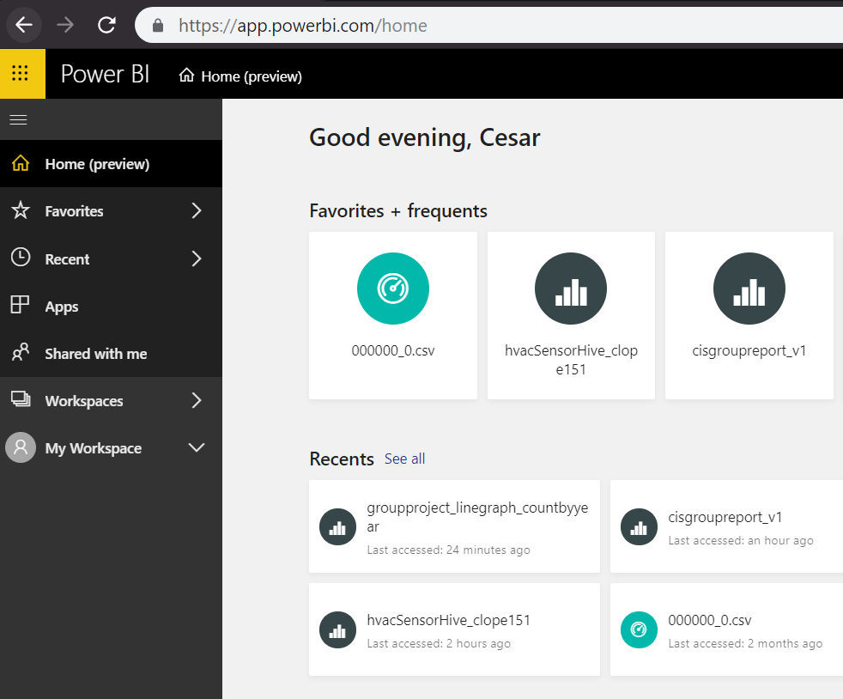
Geo-Spatial Visualization with PowerBi
PowerBi is a business analytics service that provides us with interactive visualizations based off our data.
Login Into PowerBi. Image below is an example of a home page.

Slide 25
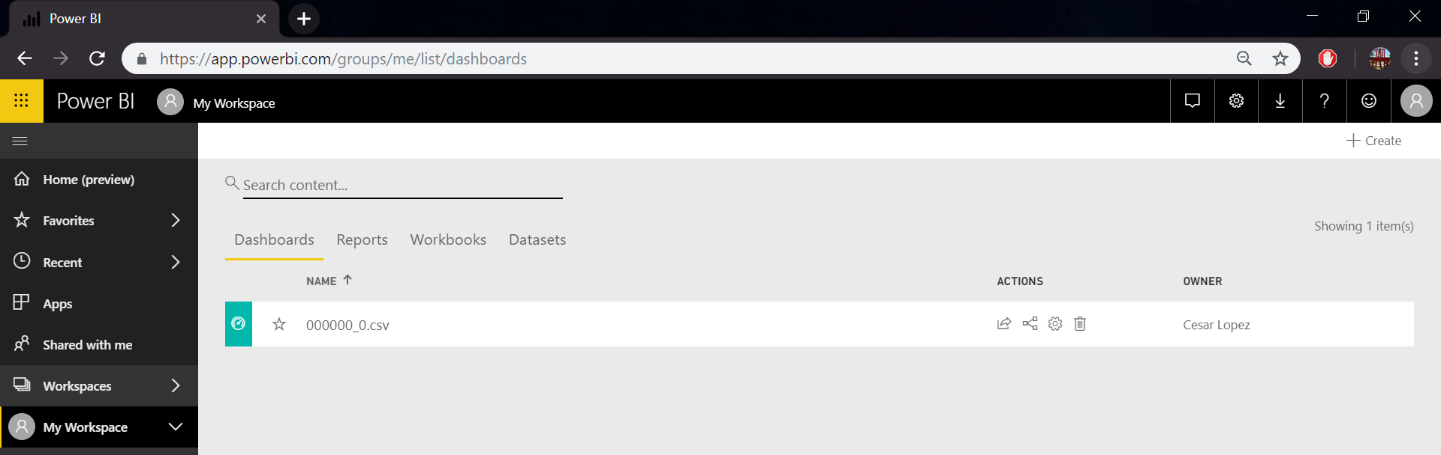
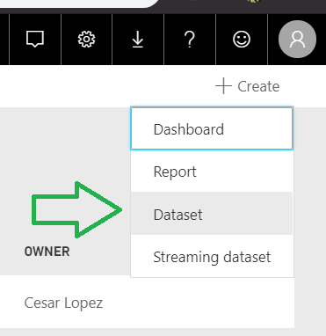
Geo-Spatial Visualization with PowerBi
Go to My Workspace
Create New Dataset by clicking the +Create button

Slide 26
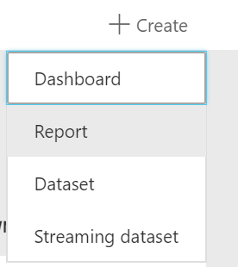
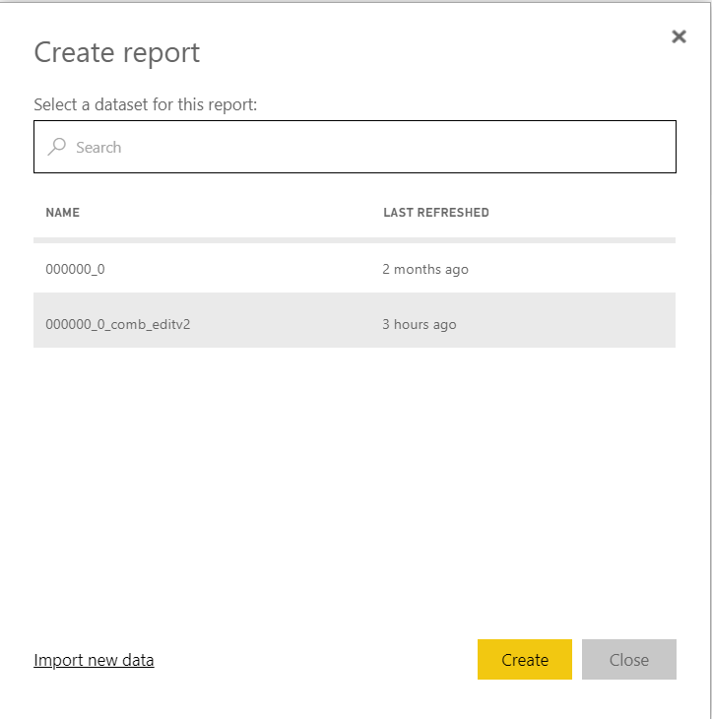
Geo-Spatial Visualization with PowerBi
Create New Report based off data set we just uploaded. Click +Create button again. When creating report make sure to select the dataset we just uploaded.

Slide 27
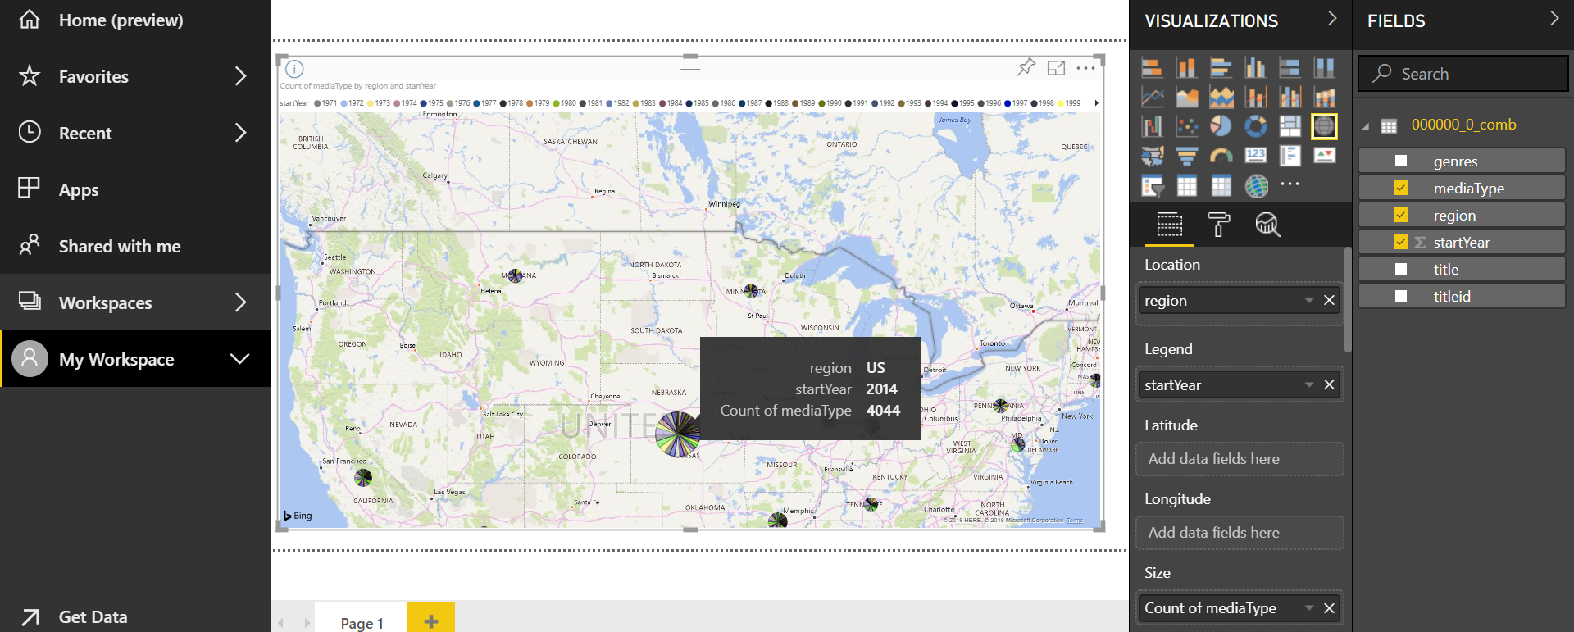
Geo-Spatial Visualization with PowerBi
Creating a Map for Geo-Spatial Visualization. Select the Map Icon. Under location drag the region field.
Then under Legend add startYear.

Slide 28
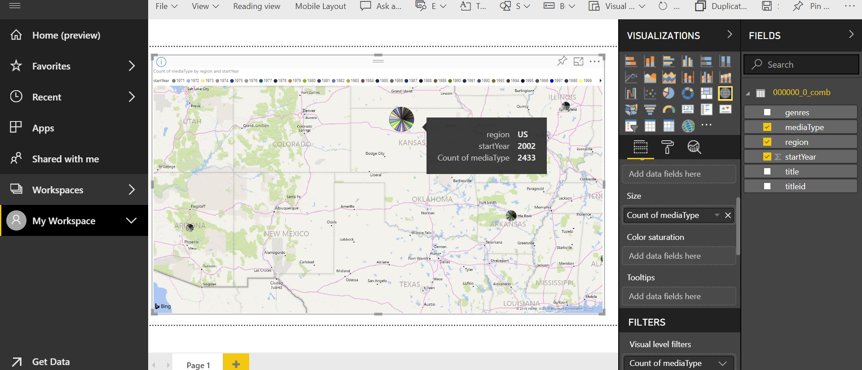
Geo-Spatial Visualization with PowerBi
Also add mediaType under size.

Slide 29
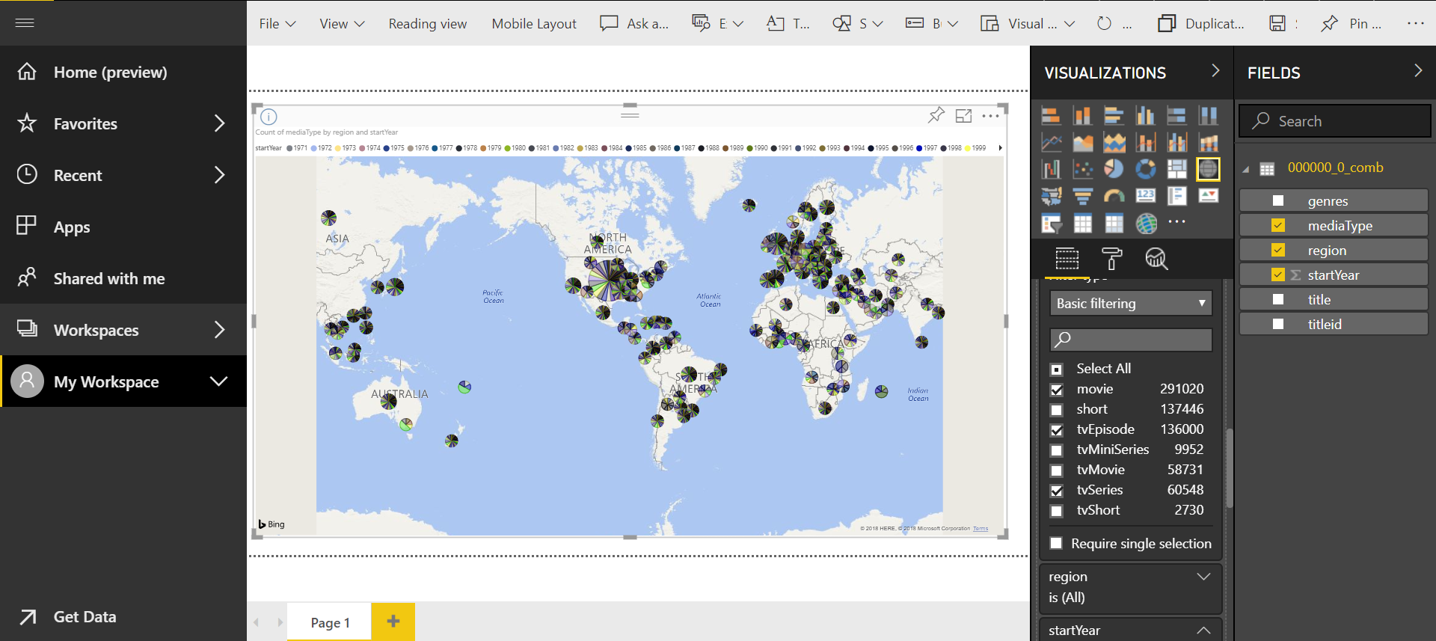
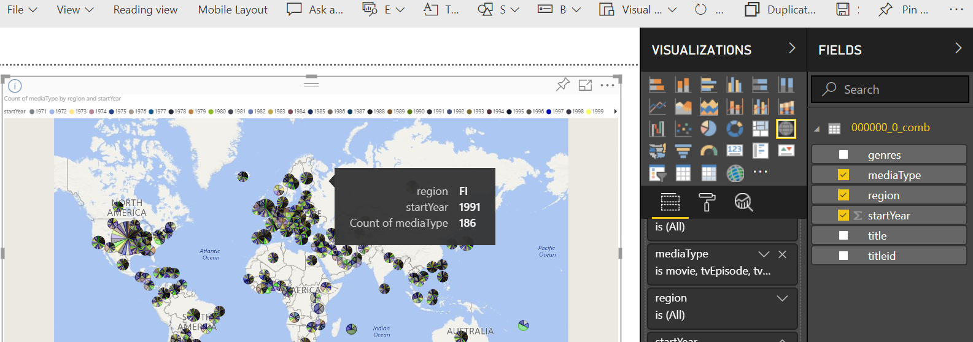
Geo-Spatial Visualization with PowerBi
We then can filter results based off the different media types released after 1970

Slide 30
Basic Query for Data Analysis
Changing region, startYear, genres, and titleType in WHERE clause will change data.
SELECT titleId, title, region, startYear, genres, titleType
FROM data_title_limit_join_innerjoin
WHERE region = 'US'
AND startYear > 1970
AND genres LIKE LIKE concat('%', 'Comedy', '%')
AND titleType = 'movie';

Slide 31
Different Ways to Analyze Data
Count US movies that were released each year
SELECT startYear, COUNT(titleId) FROM data_title_limit_join_innerjoin WHERE region = 'US' AND titleType = 'movie' GROUP BY startYear;
SEL

Slide 32
Different Ways to Analyze Data
Count US movies by titletype
SELECT titleType, COUNT(titleId) FROM data_title_limit_join_innerjoin WHERE region = 'US' GROUP BY titleType;

Slide 33
Different Ways to Analyze Data
Count US movies by titletype and year
SELECT titleType, startYear, COUNT(titleId) FROM data_title_limit_join_innerjoin WHERE region = 'US' GROUP BY titleType, startYear;

Slide 34
Different Ways to Analyze Data
Count US movies by titletype and year where genres has horror and organized by the startYear
SELECT titleType, startYear, COUNT(titleId)
FROM data_title_limit_join_innerjoin
WHERE region = 'US' and genres
LIKE concat('%', ‘Horror’, '%')
GROUP BY titleType, startYear
ORDER BY startYear;

Slide 35
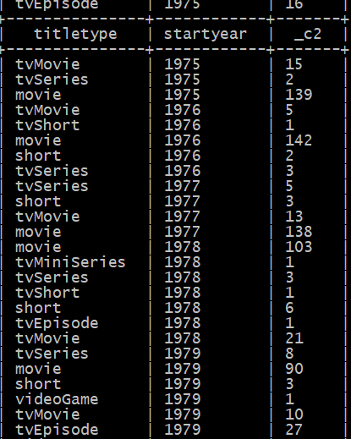

Slide 36
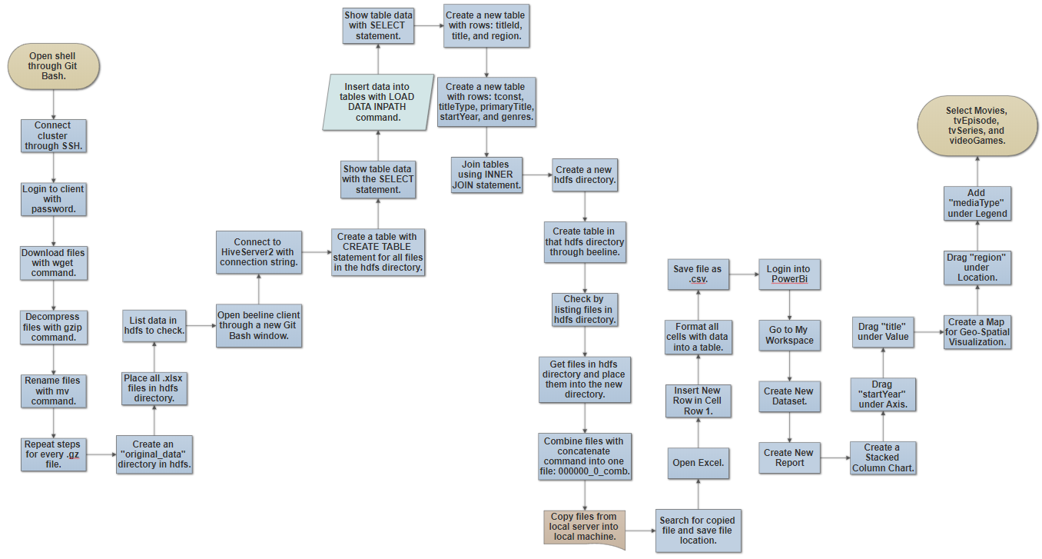
Implementation

Slide 37
Problems Encountered: Creating tables with location
CREATE EXTERNAL TABLE IF NOT EXISTS data_name_basics
(nConst STRING, primaryName STRING, birthYear STRING, deathYear STRING, primaryProfession STRING, knownForTitles STRING)
ROW FORMAT DELIMITED FIELDS TERMINATED BY '\t'
STORED AS TEXTFILE
LOCATION /user/clope151/new_data/name_basics.xlsx'
TBLPROPERTIES ('skip.header.line.count'='1');

Slide 38
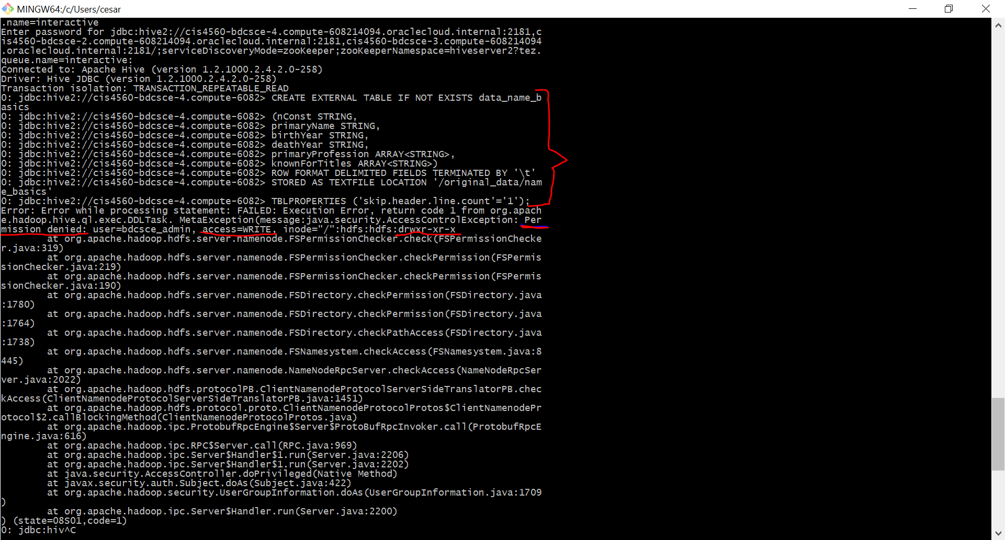


Slide 39
Solution: Creating tables with location
CREATE EXTERNAL TABLE IF NOT EXISTS data_name_basics
(nConst STRING, primaryName STRING, birthYear STRING, deathYear STRING, primaryProfession STRING, knownForTitles STRING)
ROW FORMAT DELIMITED FIELDS TERMINATED BY '\t'
STORED AS TEXTFILE
LOCATION /user/clope151/new_data/'
TBLPROPERTIES ('skip.header.line.count'='1');

Slide 40
Problems Encountered: JOINING TABLES
CREATE TABLE data_title_limit_join_leftOuter
AS SELECT takas.titleId, takas.title, takas.region,
tbasics.titleType, tbasics.startYear, tbasics.genres
FROM data_title_akas_limit takas LEFT OUTER JOIN data_title_basics_limit tbasics
ON (takas.titleId = tbasics.tconst);

Slide 41
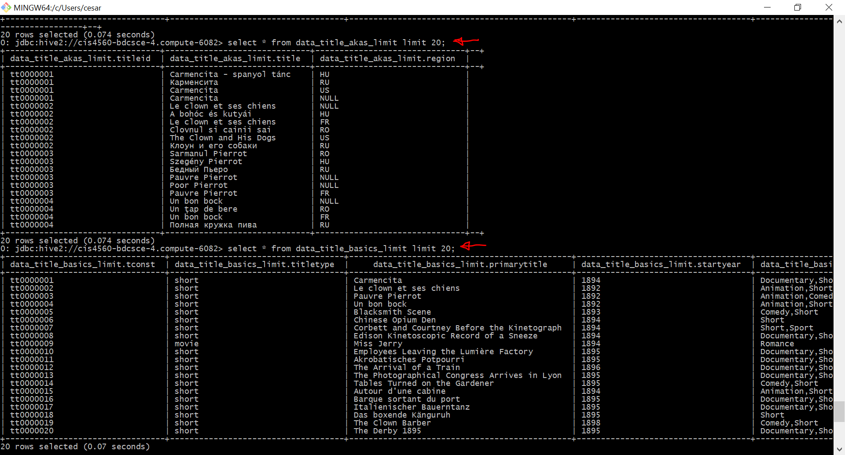

Slide 42
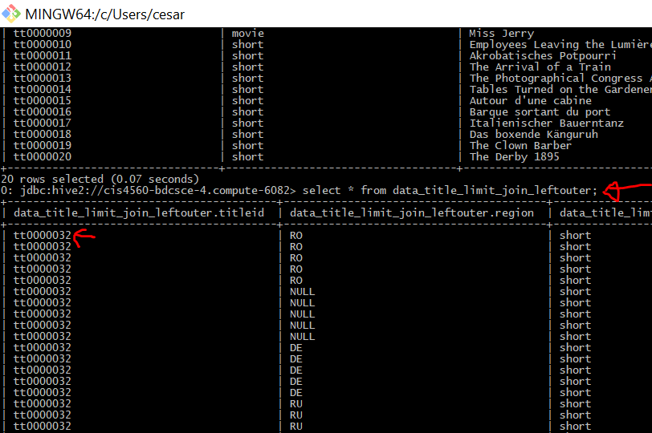

Slide 43
Solution: JOINING TABLES
CREATE TABLE data_title_limit_join_leftOuter
AS SELECT DISTINCT takas.titleId, takas.title, takas.region,
tbasics.titleType, tbasics.startYear, tbasics.genres
FROM data_title_akas_limit takas INNER JOIN data_title_basics_limit tbasics
ON (takas.titleId = tbasics.tconst);

Slide 44
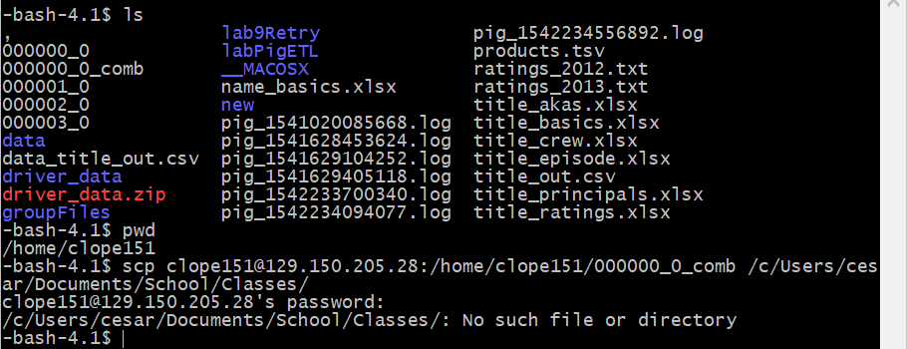
Problems Encountered: Securely Copying FIles
scp clope151@129.150.205.28:/home/clope151/000000_0_comb /c/Users/cesar/Documents/School/Classes/

Slide 45
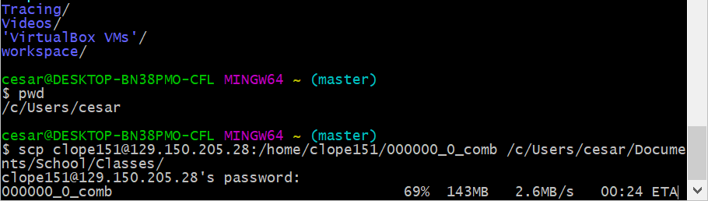
Solution: Securely Copying Files
scp clope151@129.150.205.28:/home/clope151/000000_0_comb /c/Users/cesar/Documents/School/Classes/

Slide 46

Github
Project Repository can be found at: https://github.com/SelipeProducts/IMDB-Intro-to-Data-Analysis-using-Hive

Slide 47

Conclusion
Take Away
What We Learned

Slide 48


